Slide 1
CE 3372 Water Systems Design
Lesson 11 PArT 1: storage and extended period simulation Fall 2020

Slide 2
Overview
EPANET Tank Model(s)
Single period simulation
Multiple Period Simulation
Reasons
Multiplier Table

Slide 3
Readings
EPA NET User Manual – how to model storage tanks in a water distribution system.
Interesting web-resources
http://www.invisiblestructures.com/rainstore3.html
http://www.upout.com/blog/san-francisco-3/heres-what-it-looks-like-under-those-brick-circles-in-the-street

Slide 4
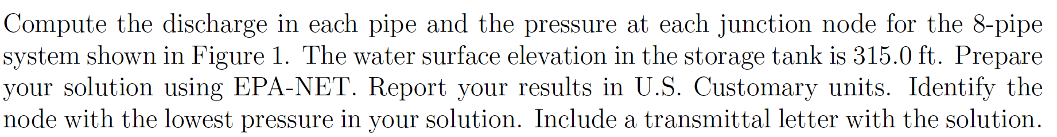
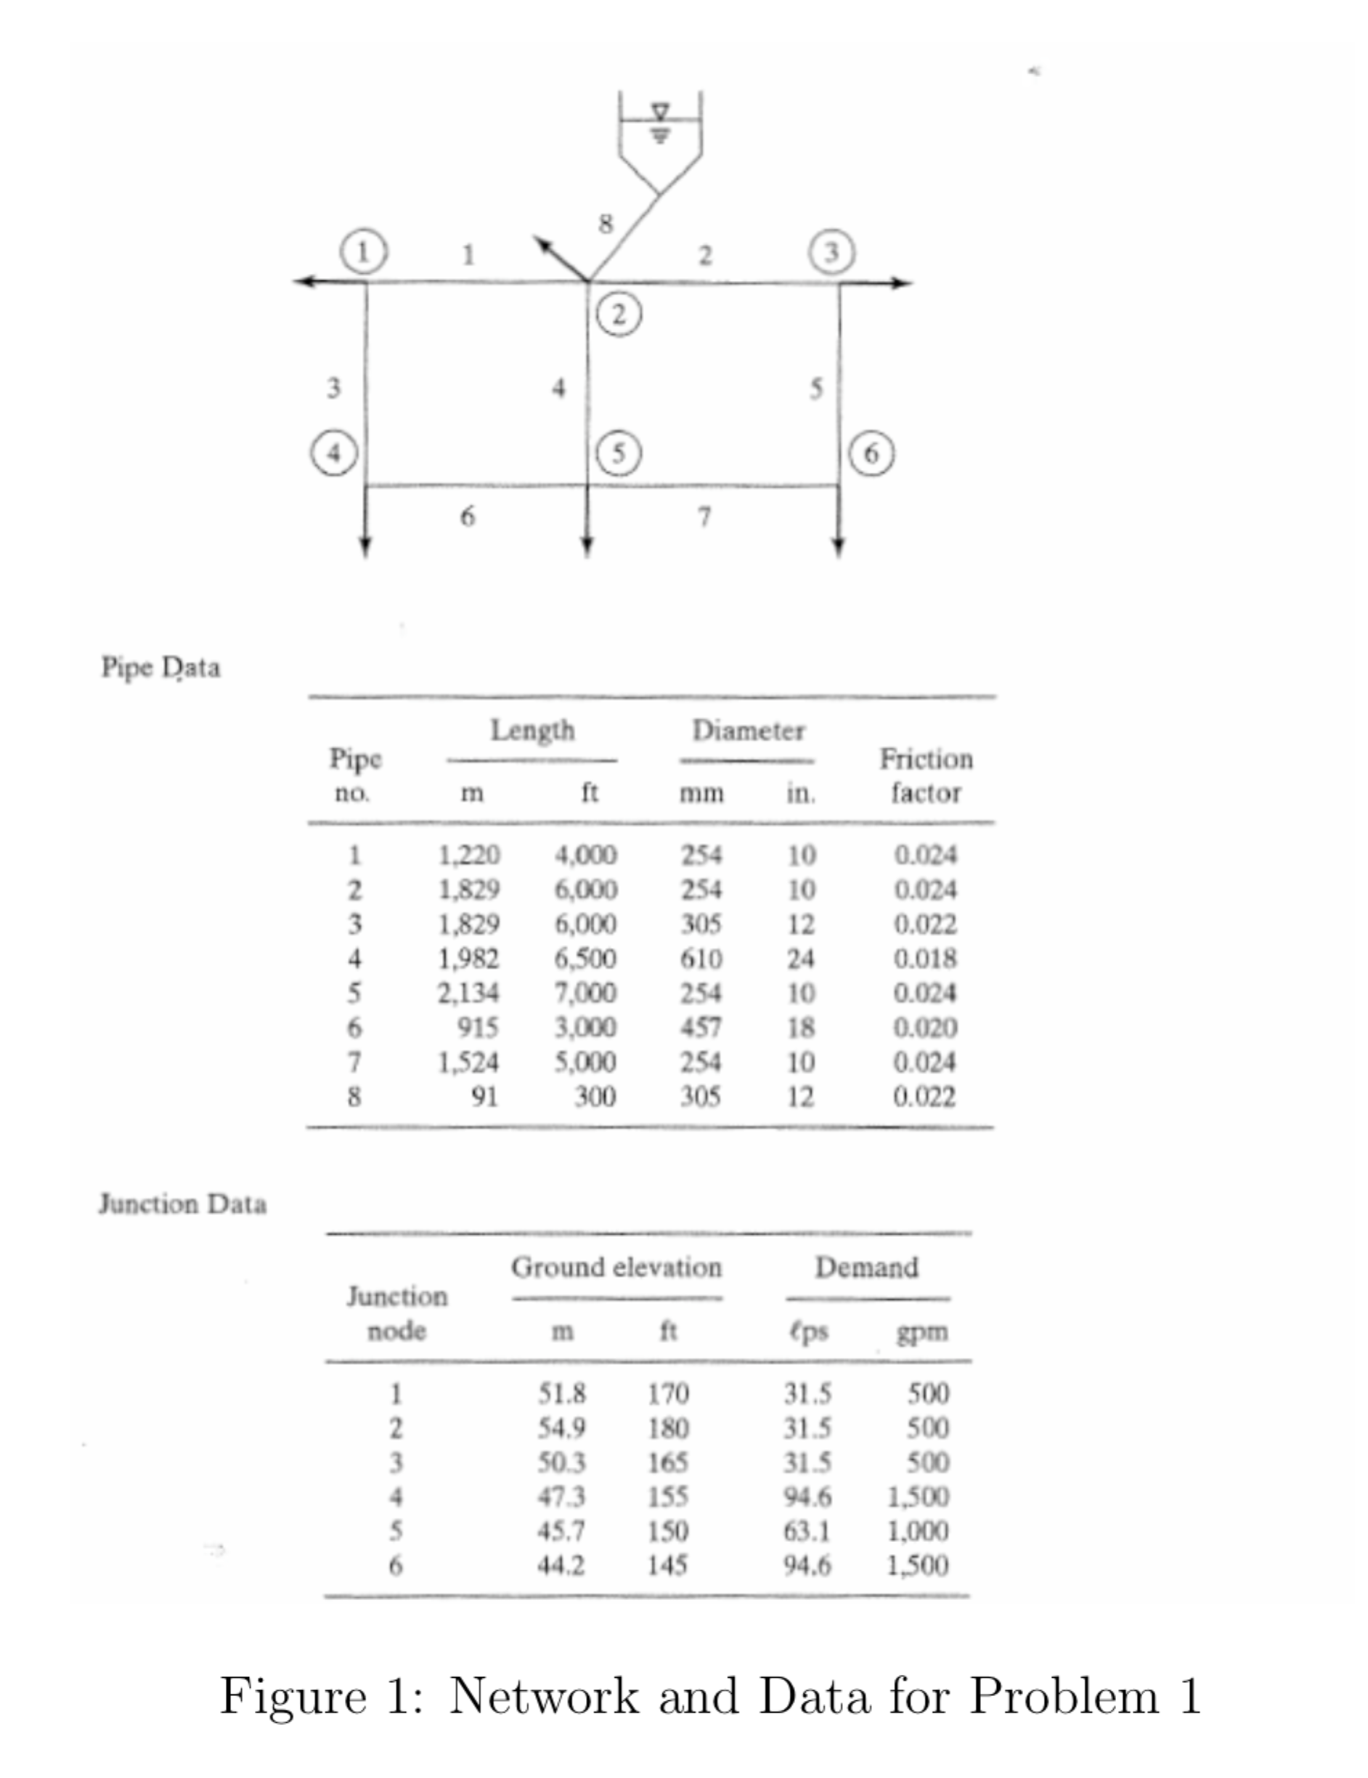
Recall earlier example

Slide 5
Modeling Protocol
Sketch a layout on paper
Identify pipe diameters; length; roughness values
Identify node elevations; demands
Supply reservoir (or tank); identify reservoir pool elevation
Identify pumps; pump curve in problem units
Notes:
Globe is most used.

Slide 6
Tank
Supply reservoir (or tank); identify reservoir pool elevation
May need assumptions
Tank dimensions should be sensible
Pipe length is given
Diameter
Z=315 ft
Max Level
Z=300 ft
Min Level
L₂=120 ft
Node 2
Pipe 8: L₁ + L₂ = 300 ft
Z=180 ft
Elevation
L₁=180 ft
Notes:
Globe is most used.

Slide 7
Extended period simulation
EPANET and similar programs find steady-flow solutions
Extended period simulation produces a sequence of steady states with approximations for:
Tanks drain and fill
Pressures can change at beginning and end of a time interval
Pump operating points moving along a pump curve

Slide 8
Uses
Extended period simulation used for:
Modeling pressure in systems during changing demand –usually at hourly time scale
Storage tank operation and sizing
Water quality simulation
EPANET can approximate water quality from multiple sources – has uses in
Water age in system
Detection of intrusions into a system
Severity of contamination (impact assessment)

Slide 9
How implemented?
In EPANET assign a demand pattern to a node
Set simulation times
Program then follows the pattern

Slide 10
Modeling Protocol
Sketch a layout on paper
Identify pipe diameters; length; roughness values
Identify node elevations; demands
Supply reservoir (or tank); identify reservoir pool elevation
Identify pumps; pump curve in problem units
Identify demand pattern(s) and tank operating considerations
Notes:
Globe is most used.

Slide 11
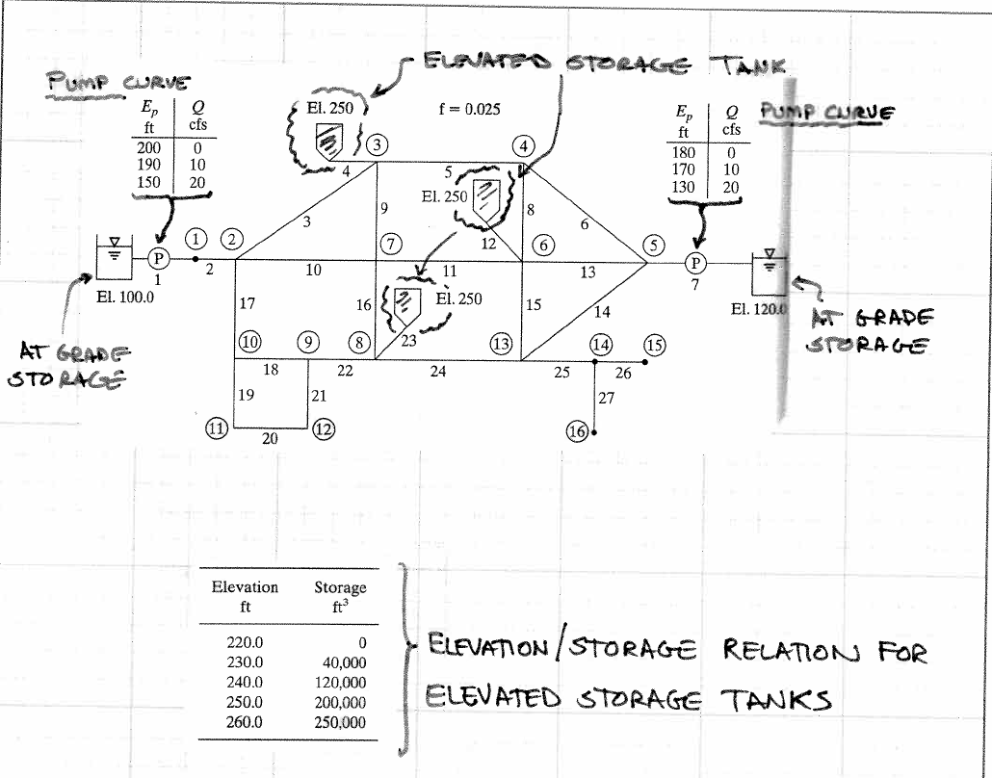
example

Slide 12
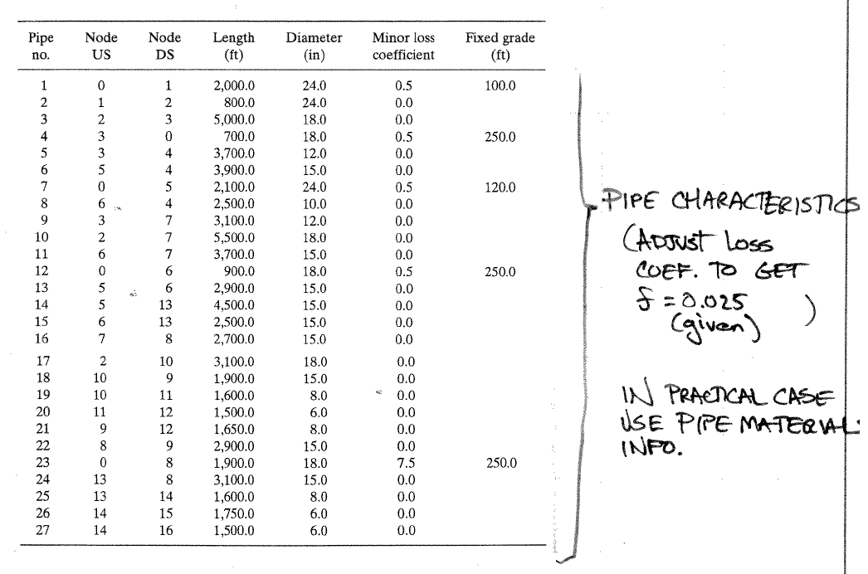
Illustrate by example

Slide 13
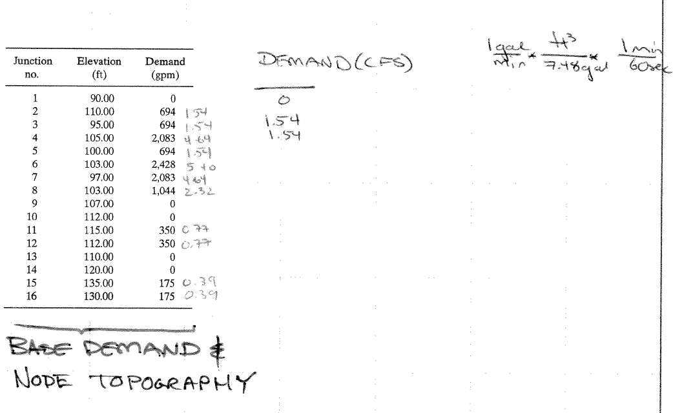
Illustrate by example

Slide 14
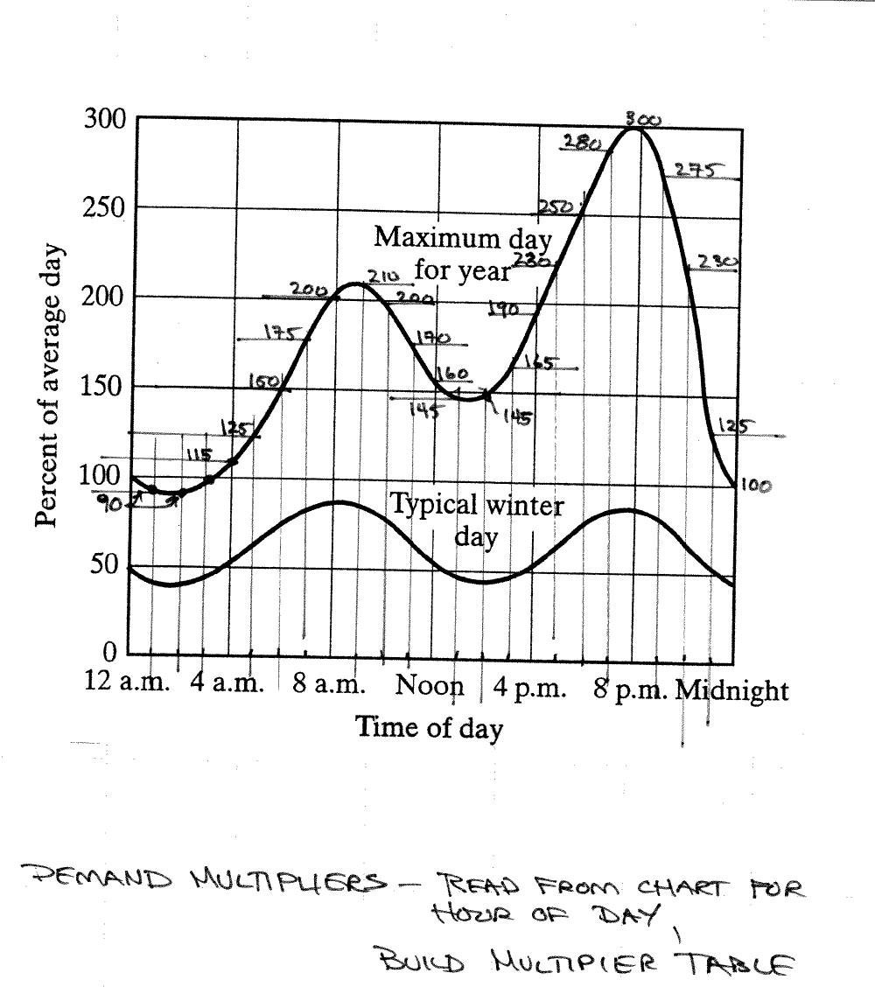
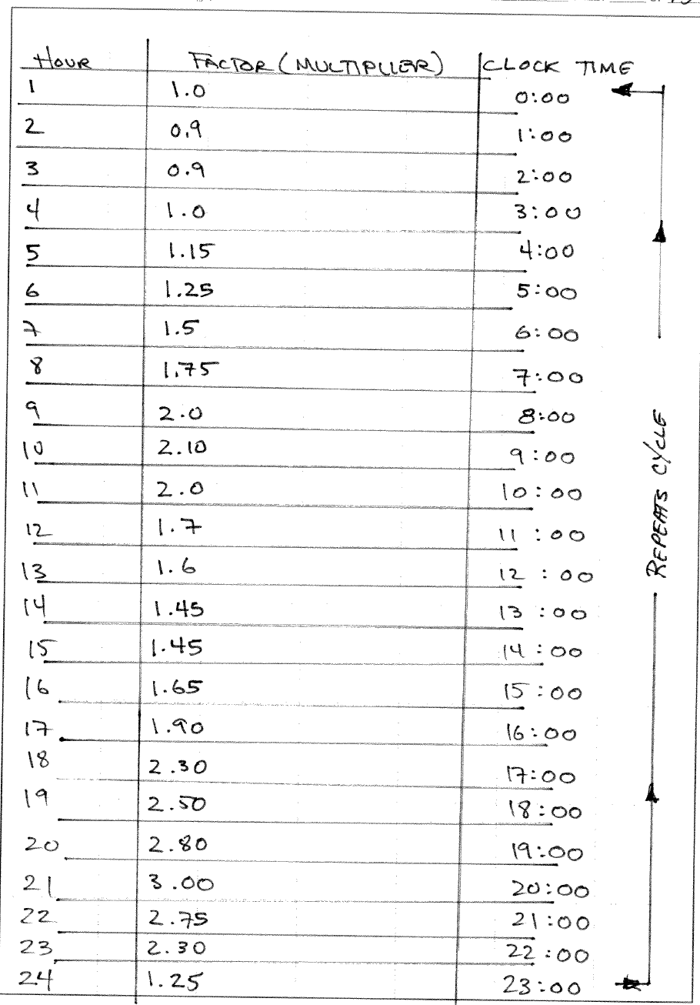
Illustrate by example

Slide 15
Illustrate by example
Build network layout
Nodes (junctions, tanks, reservoirs)
Links (pipes, pumps, valves)
Add pump curves
BROWSER/DATA/CURVES/ADD (TYPE=PUMP)
Add storage curves
BROWSER/DATA/CURVES/ADD (TYPE=STORAGE)
Add demand pattern(s)
BROWSER/PATTERNS/ADD

Slide 16
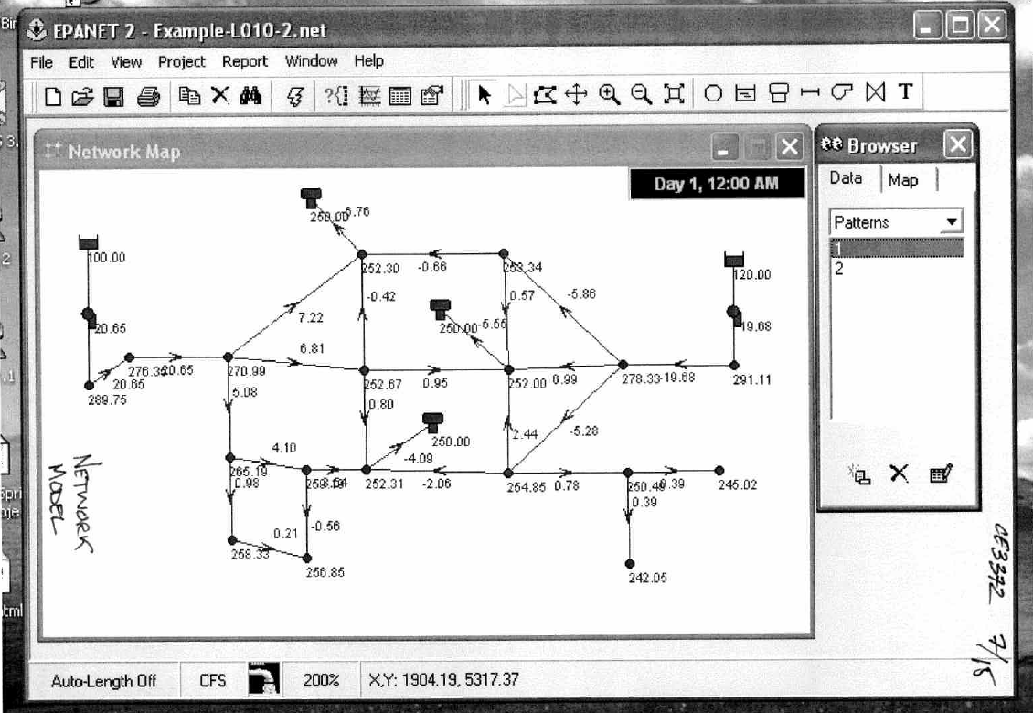
Illustrate by example

Slide 17
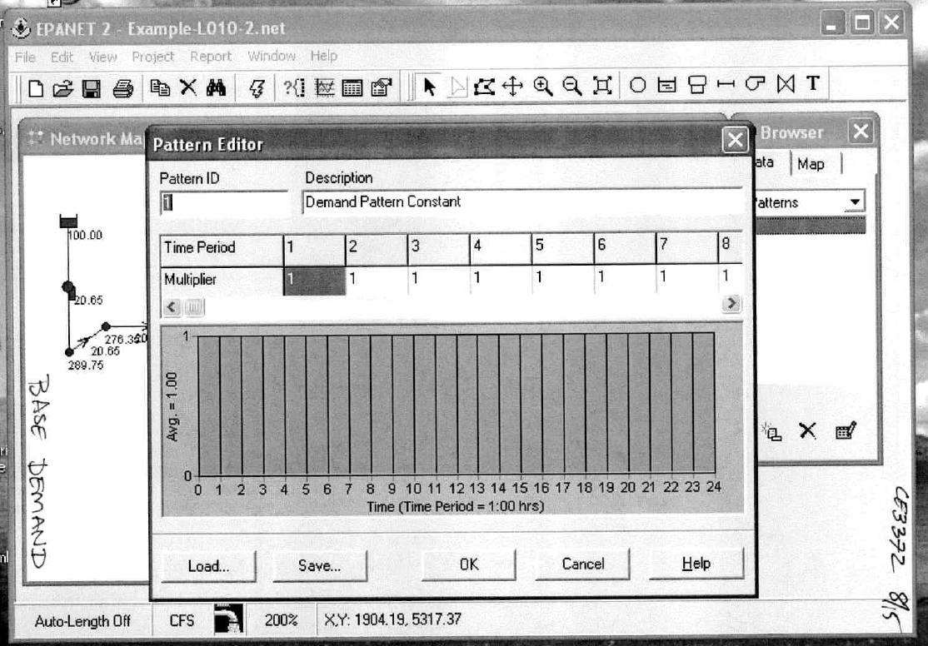
Illustrate by example

Slide 18
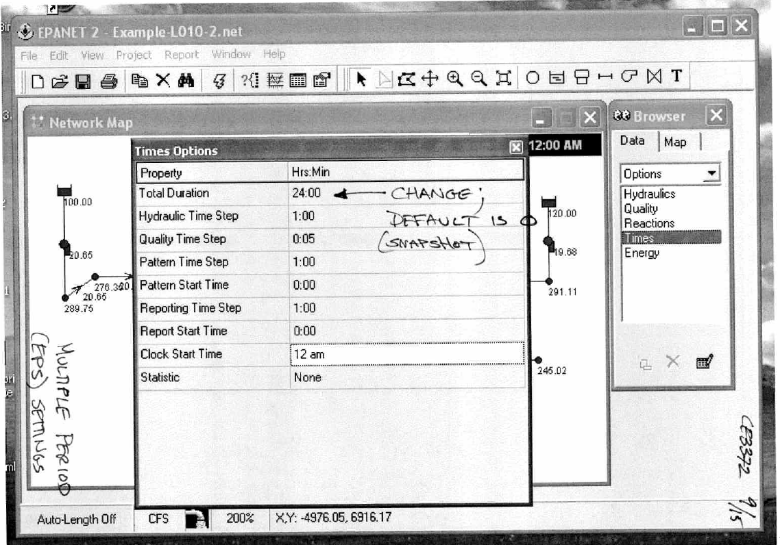
Illustrate by example

Slide 19
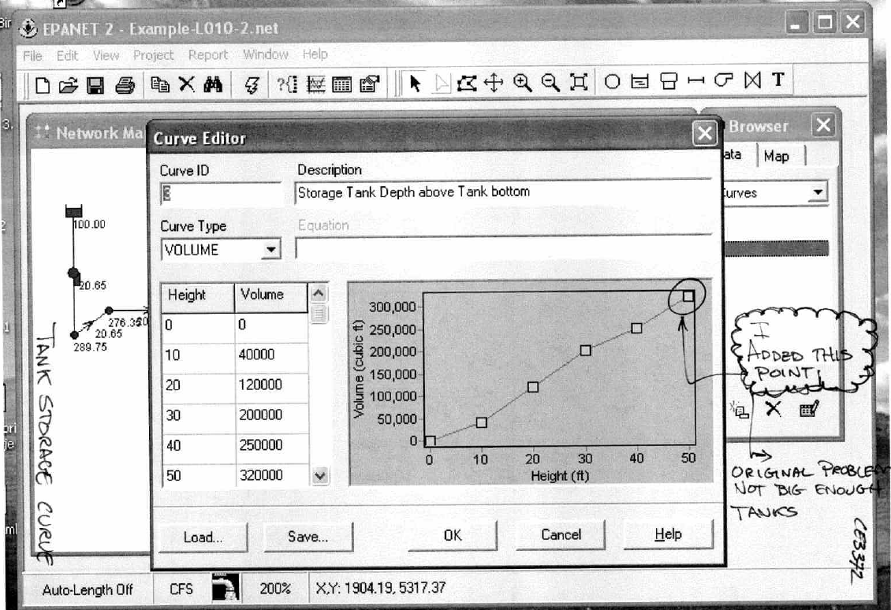
Illustrate by example

Slide 20
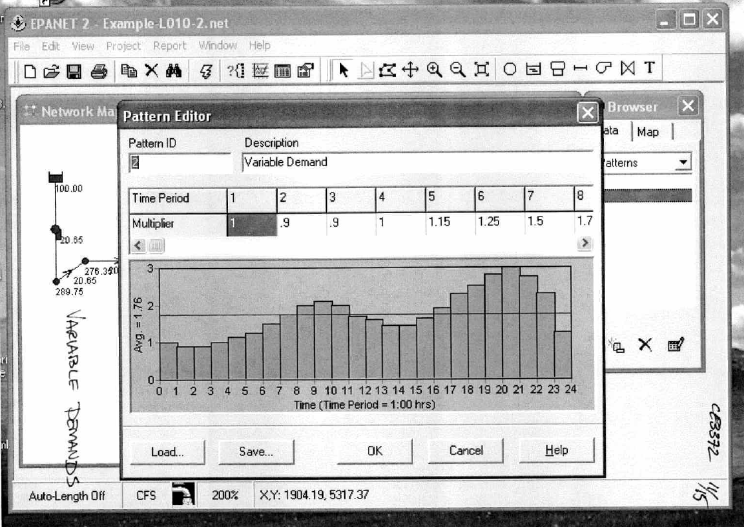
Illustrate by example

Slide 21
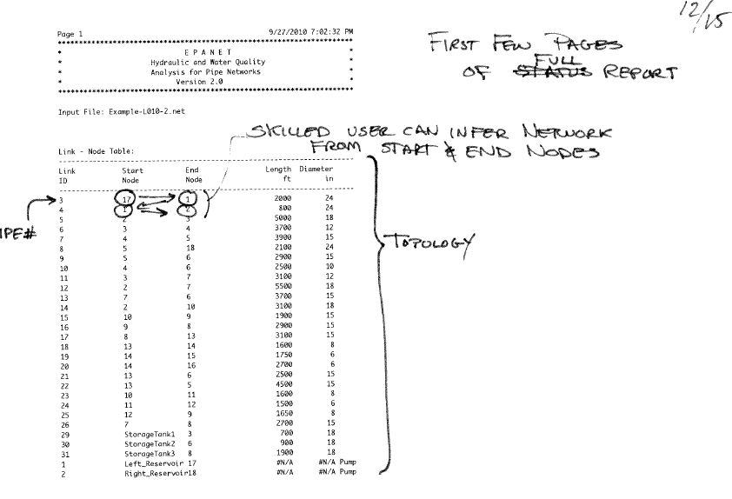
Report output

Slide 22
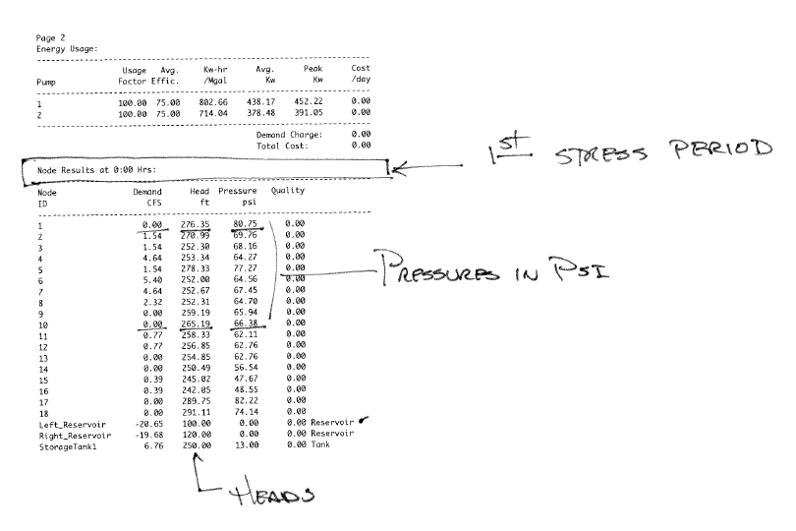
Report output

Slide 23
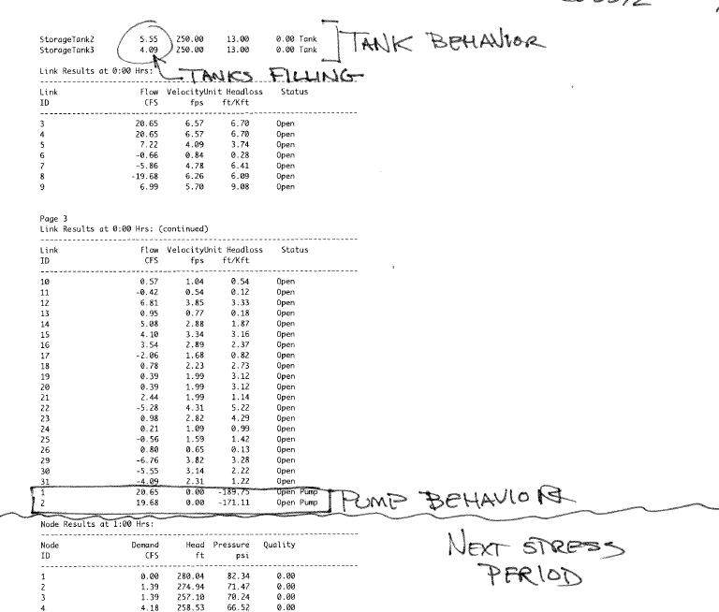
Report output

Slide 24
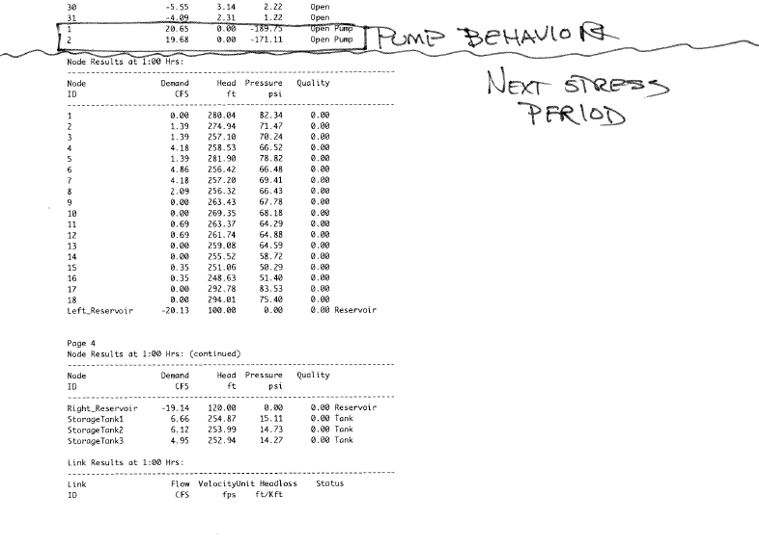
Report output

Slide 25
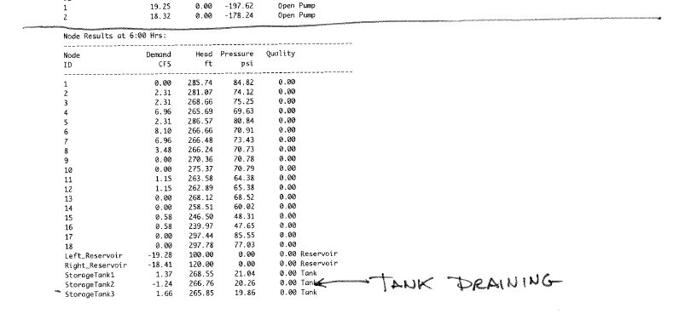
Report output

Slide 26
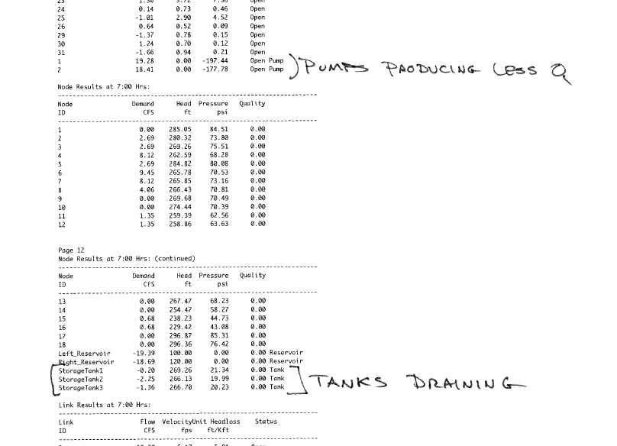
Report output

Slide 27
CE 3372 water systems design
Lesson 11 Part 2 : Water Quality in EPANET FALL 2020

Slide 28
Outline
EPA-NET Water Quality Models
Theory:
Advective Transport in Pipeline
Decay
Practice:
Estimate water age in system
Estimate concentration of constituent at different points in network
Respond to intrusions into the system

Slide 29
Water Quality in EPANET
Transport theory in EPANET
Lagrangian Approach (Discrete Parcel Advection)
Mixing Approach (in tanks)

Slide 30
Advective Transport
Advection (convection) is the transport of dissolved or suspended material by motion of the host fluid.
Requires knowledge of the fluid velocity field (the velocity of a fluid particle)
Velocity from EPANET hydraulics

Slide 31
Mean Section Velocity
L
A
Q
L
t=0
Pipe Segment:
Volume = L*A
Flow Rate = Q
t=0.2 Δ t
Displacement of one segment
volume takes a certain time, Δt
t=0.4 Δ t
Δ t=L*A/Q
Distance traveled by marker is segment length, L;
Marker velocity is distance/time
t=0.6 Δ t
t=0.8 Δ t
t=1.0 Δ t

Slide 32
Mass Flux
wL
Suppose one “blue” volume enters the pipe segment.
The mass of “blue” per unit volume is the concentration of blue.
Let one pipe volume enter the segment.
Total mass of blue in the segment is the concentration*fluid volume
Rate of blue entering the segment is mass/time
t=0
t=0.5Δt
t=1.0Δt

Slide 33
Mass Balance
Now consider a small portion of the pipe.
1
2
ΔL
Mass flow into segment.
Mass flow out of segment.
Rate of accumulation in segment.
-
=

Slide 34
Balance Equations
For a non-deforming medium this mass balance is expressed as:
Substituting the definition of average linear velocity:
Taking the limit as ΔL vanishes produces the fundamental equation governing convective transport.

Slide 35
generalization
Express last term in more conventional form – divergence of the mass flux is equal to the rate of change of concentration at a point.
Observe the obvious dependence on the velocity field (u,v,w).
In order to compute any mass fluxes we must first determine the velocity values in the domain of interest.

Slide 36
Analytical Model
Distance along flow path, x
Velocity, V
Pulse Length, L
Water at a constant velocity, V , is flowing through the zone carrying the dissolved component at a specific concentration, C_{o}.
There is no degradation of the component, no dispersion of the component, nor is there any interaction with the solid phase (walls).
The zone translates in space at a rate determined by the water velocity.
The contaminant is dissolved, and does not alter the density of the flowing water.
The contaminant is assumed to be uniformily mixed in contaminated zone.
Notes:
There is no degradation of the component, no dispersion of the component, nor is there any interaction with the solid phase (walls) – called the”tracer” hypothesis
The zone translates in space at a rate determined by the water velocity.
The contaminant is dissolved, and does not alter the density of the flowing water. Dilute system – if C are big enough, density will change- the mathematics gets difficult beause the velocity will change as a function of density, even in otherwise steady state conditions. Denisty gradients are common in WWTP reactors and estuary systems. Generally in water distribution systems, the contaminant concentrations are small and dilute system hypothesis is justified.
The contaminant is assumed to be uniformily mixed in contaminated zone – called a completely back-mixed system. Common model of system in chemical reaction modeling. You would know it as a plug-flow-system from environmental engineering class.

Slide 37
Governing Equations, Initial, and Boundary Conditions
The governing equation of mass transport for this case is:
The initial conditions throughout the pipe segment are:
The boundary conditions at the source are:
The solution for this case is:
Notes:
The solution is called the color-equation, but almost no-one calls it that anymore.

Slide 39
Cell Balance Model Approach
Suppose at t=0 the concentration in the inlet cell is Co. We want to determine the concentration in the pipe segment at future times.
We will assume the velocity is identical throughout the column.
A simple modeling approach is to treat each cell as completely mixed.
This means that the concentration at the cell exit is identical to the concentration in the cell.
Cell 1
Inlet
ΔL
Cell 2
Cell 3
Cell 4
Outlet
Cell 5

Slide 40
c=0
Cell 1
c=c₁
Cell 2
ΔL
c=c₂
Cell 3
c=c₃
Cell 4
c=c₄
Cell 5
c=c₅

Slide 42
Timed Release Case
At the origin (x=0) a contaminant is added to the flowing water at fixed concentration C_{o} for a period of time t.
At the end of the time period the contaminant addition is stopped.
By the end of the time period a “parcel” of contaminated water is created.
Mechanism of release does not disturb the local flow field in any fashion.
Contaminant is assumed to be uniformily mixed in the parcel (zone)

Slide 43
Solution
Solution identical to first case.
Substitute vτ = L into the previous solution.

Slide 44
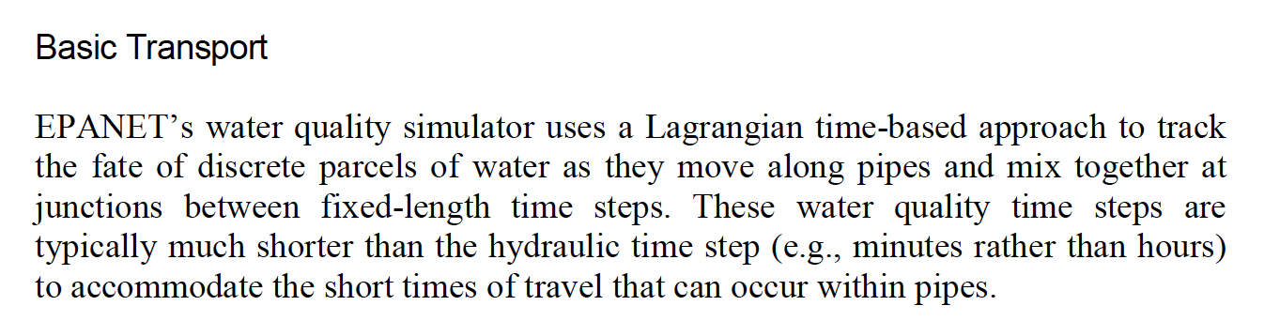
In EPANET HOW these are implemented

Slide 45
Mixing at node
When parcels (concentration) reaches a node where there are multiple mass fluxes, a flow-weighted mixing model is used to compute the concentration at that node (which will become a new C₀ for any downstream links)

Slide 46
Mixing in a tank
Tank mixing is handled by four possible models:
Completely mixed (CFSTR)
Two-Compartment Mixing
FIFO Plug Flow
LIFO Plug Flow

Slide 47
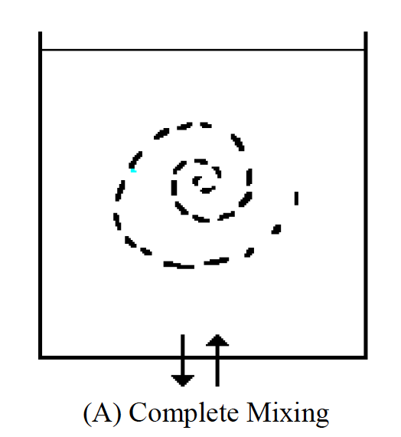
Completely mixed
All water entering tank instantly and completely mixes
Reasonable for small tanks, or hydraulic time steps that are long compared to transport time steps
Notes:
The Complete Mixing model (Figure 3.5(a)) assumes that all water that enters a tank
is instantaneously and completely mixed with the water already in the tank. It is the
simplest form of mixing behavior to assume, requires no extra parameters to describe
it, and seems to apply quite well to a large number of facilities that operate in filland-
draw fashion.

Slide 48
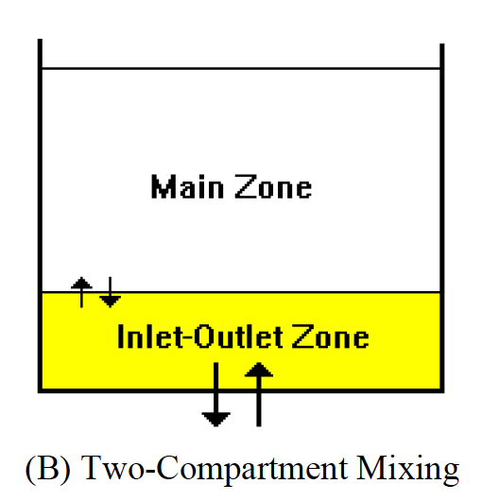
Two-compartment mixing
Tank storage divided into two compartments
Inlet/Outlet zone
Main Zone
When Inlet/Outlet zone is filled, then spills into main zone
Notes:
The Two-Compartment Mixing model (Figure 3.5(b)) divides the available storage
volume in a tank into two compartments, both of which are assumed completely
mixed. The inlet/outlet pipes of the tank are assumed to be located in the first
compartment. New water that enters the tank mixes with the water in the first
compartment. If this compartment is full, then it sends its overflow to the second
compartment where it completely mixes with the water already stored there. When
water leaves the tank, it exits from the first compartment, which if full, receives an
equivalent amount of water from the second compartment to make up the difference.
The first compartment is capable of simulating short-circuiting between inflow and
outflow while the second compartment can represent dead zones. The user must
supply a single parameter, which is the fraction of the total tank volume devoted to
the first compartment.

Slide 49
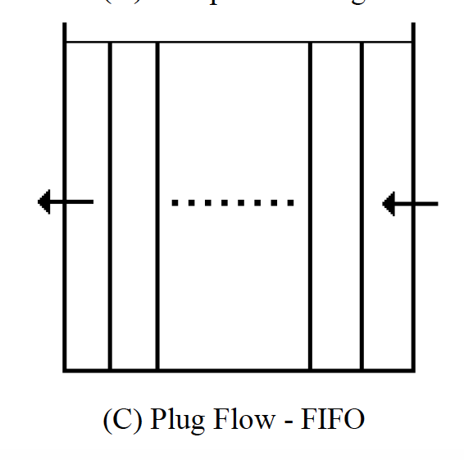
Fifo mixing
The first parcel (volume) of water to enter the tank, is first parcel to leave
Essentially plug-flow in the tank
Notes:
The FIFO Plug Flow model (Figure 3.5(c)) assumes that there is no mixing of water
at all during its residence time in a tank. Water parcels move through the tank in a
segregated fashion where the first parcel to enter is also the first to leave. Physically
speaking, this model is most appropriate for baffled tanks that operate with
simultaneous inflow and outflow. There are no additional parameters needed to
describe this mixing model.

Slide 50
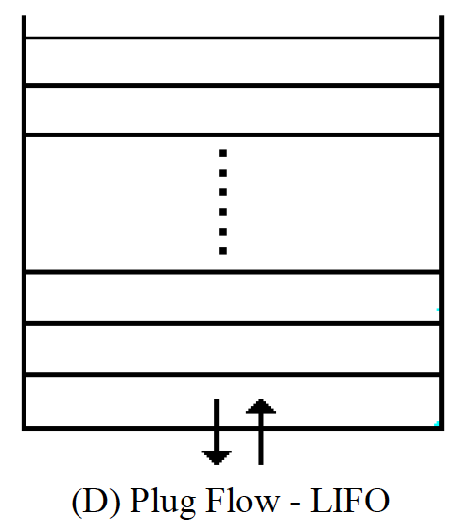
Lifo mixing
The last (most recent) parcel (volume) of water to enter the tank, is first parcel to leave
Essentially stratified-flow in the tank
Notes:
The LIFO Plug Flow model (Figure 3.5(d)) also assumes that there is no mixing
between parcels of water that enter a tank. However in contrast to FIFO Plug Flow,
the water parcels stack up one on top of another, where water enters and leaves the
tank on the bottom. This type of model might apply to a tall, narrow standpipe with
an inlet/outlet pipe at the bottom and a low momentum inflow. It requires no
additional parameters be provided.

Slide 51
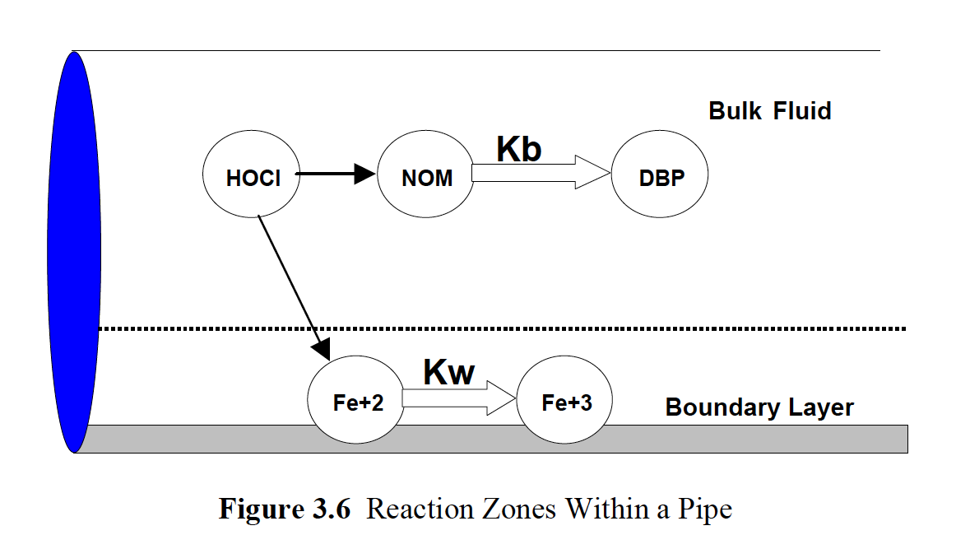
Water quality reactions
Bulk reactions (in the parcel)
Wall reactions (at the parcel, pipe-wall interface)

Slide 52
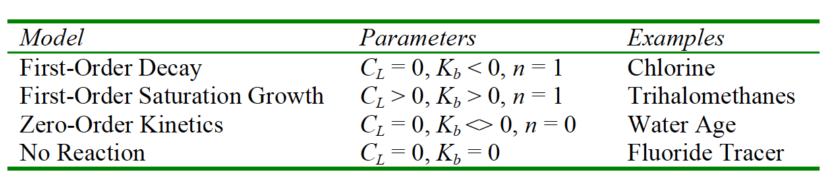
BULK reactions
Growth and decay of constituent in the bulk phase (parcel)
Uses choice of
No reaction
Zero-Order kinetics
1-st Order Decay
1-st Order Saturation

Slide 53
Wall reactions
Handled in similar fashion – generally a secondary reaction term based on location in the network

Slide 54
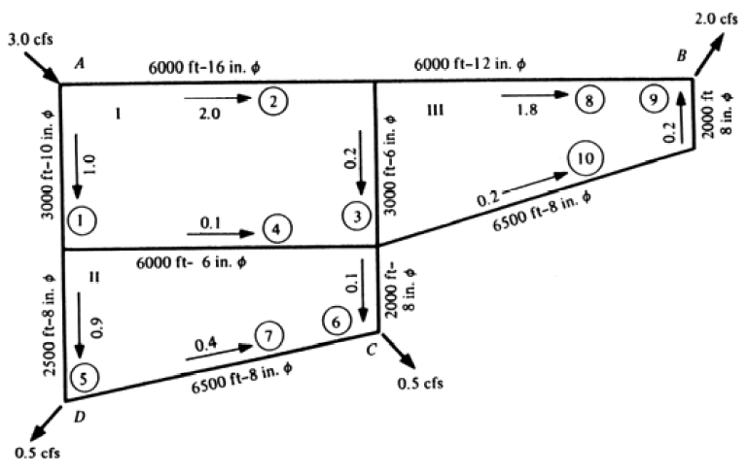
Example
What is the disinfection residual in the system below if the source water has chloramine at 10 mg/L and the first-order decay mass transfer coefficient (K_{b}) is -5?

Slide 55
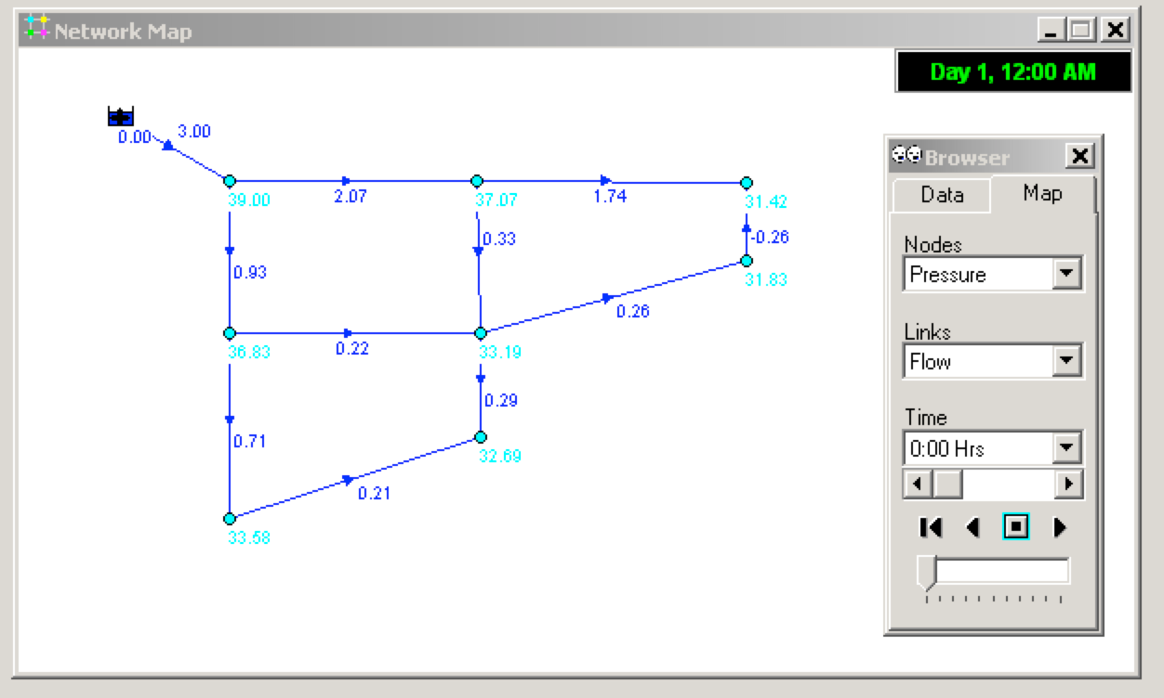
Example
What is the disinfection residual in the system below if the source water has chloramine at 10 mg/L and the first-order decay mass transfer coefficient (K_{b}) is -5
Build the hydraulic simulation – verify works

Slide 56
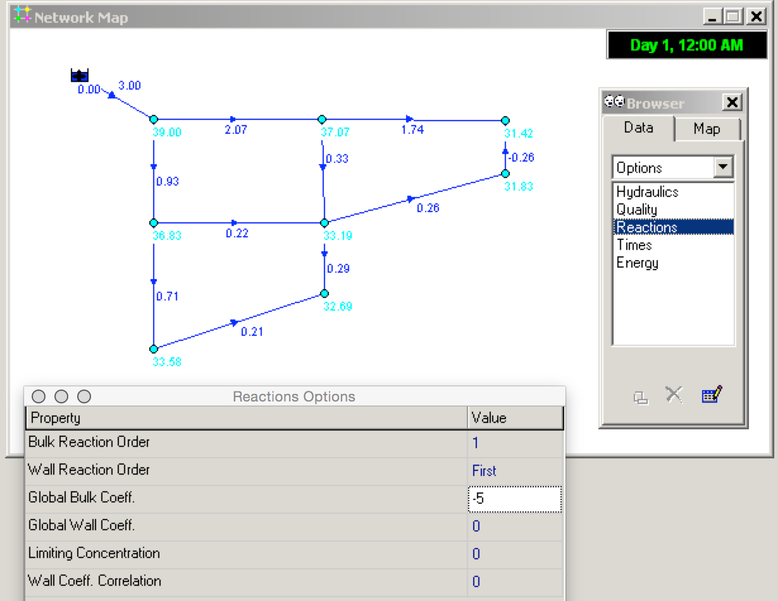
Example
Select
Data/Options/Reactions
Set Bulk Coefficient; Reaction Order

Slide 57
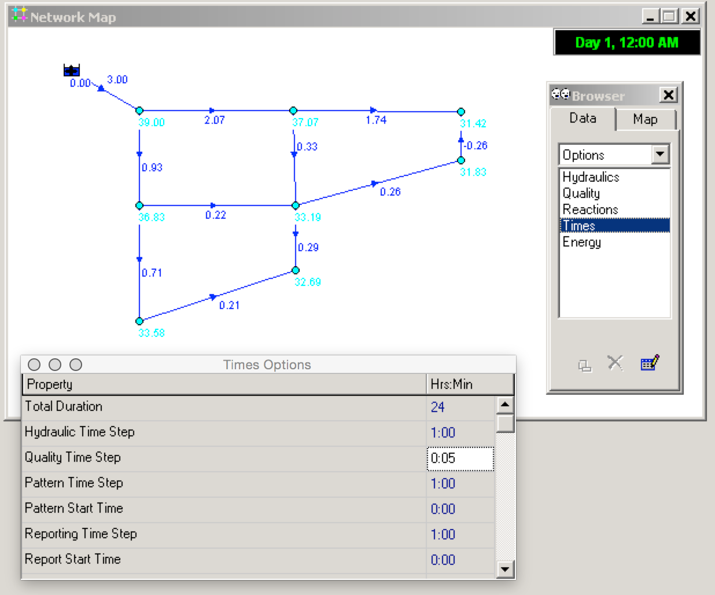
Example
Select
Data/Options/Times
Set a total simulation duration (how many Hydraulic Time Steps to Take

Slide 58
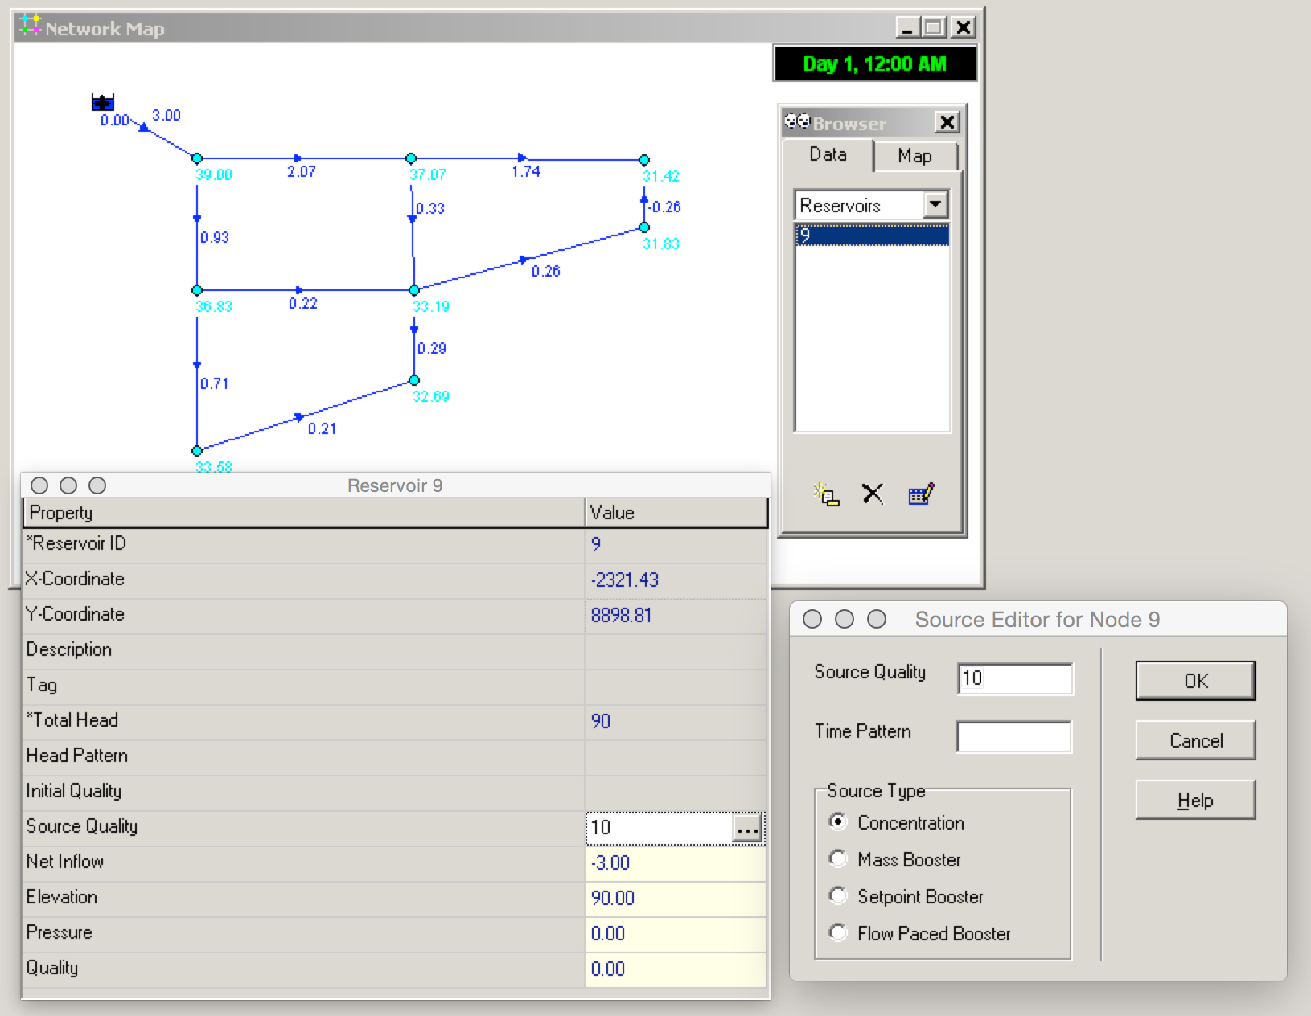
Example
Select
Data/Reservoirs/…
Set a source quality and source type

Slide 59
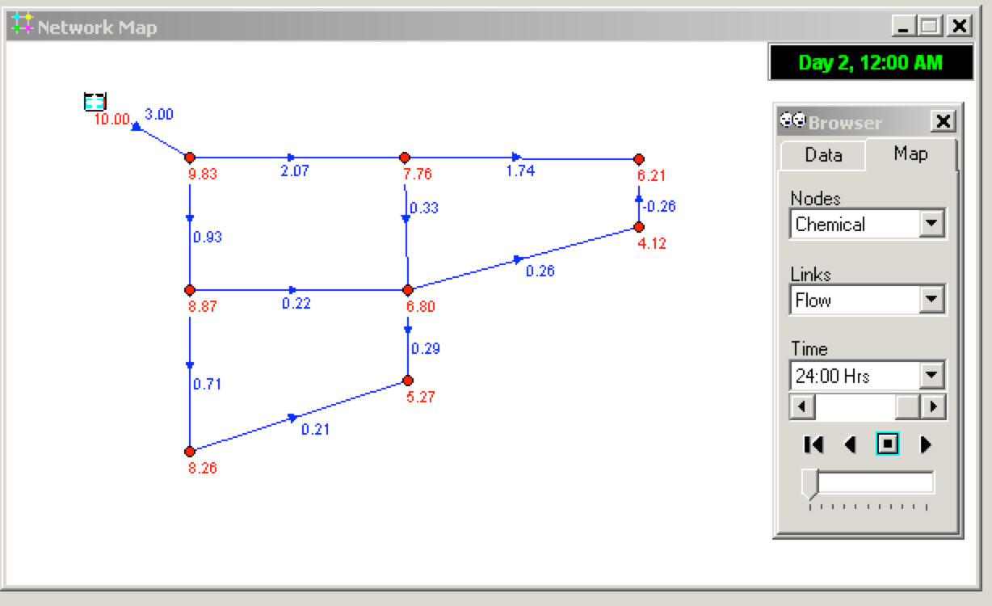
Example
Run the model, then step through the times until steady state
Interpret results
Notes:
Here we see residual less than 5 ppm. Therefore this system would not meet state minimum requirements. So increase dose at reservoir or inject added chemicals elsewhere.

Slide 60
Additional concepts
A “tracer” can be used to estimate water age in the system (its treated as a different constituent)
Use Zero-Order reaction with K_{b} = 1; resulting “concentration” is water age in Hydraulic Time Steps
Multiple sources can be used to estimate mixing in a system (homework)
Intrusions of contaminants can be modeled (inject a dose at a node, and see where it arrives).

Slide 61
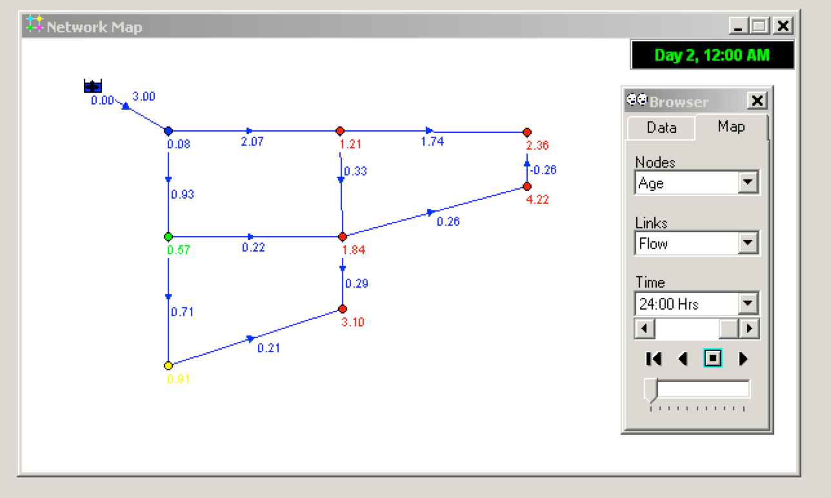
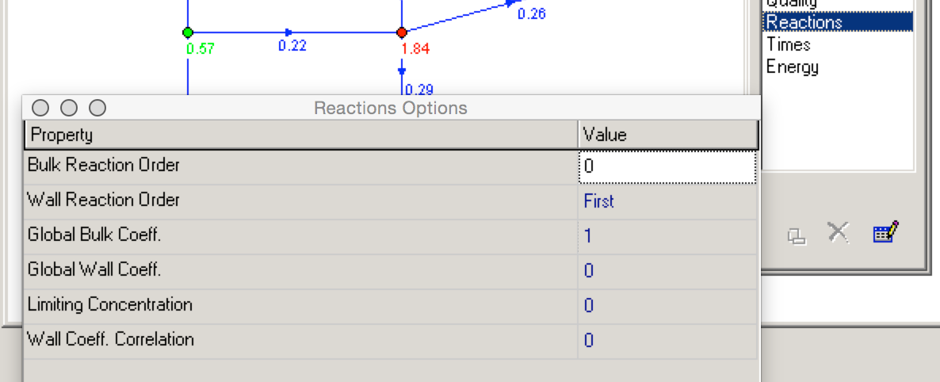
Example
What is the water age in hours the system below?
Run the model, then step through the times until steady state
Interpret results
Notes:
Water average age at the low PPM node to be 4.2 hours.

Slide 62
NEXT TIME
Open Channel Flow
Uniform flow
Gradually Varied Flow
Hydraulic Elements

